Slide 1
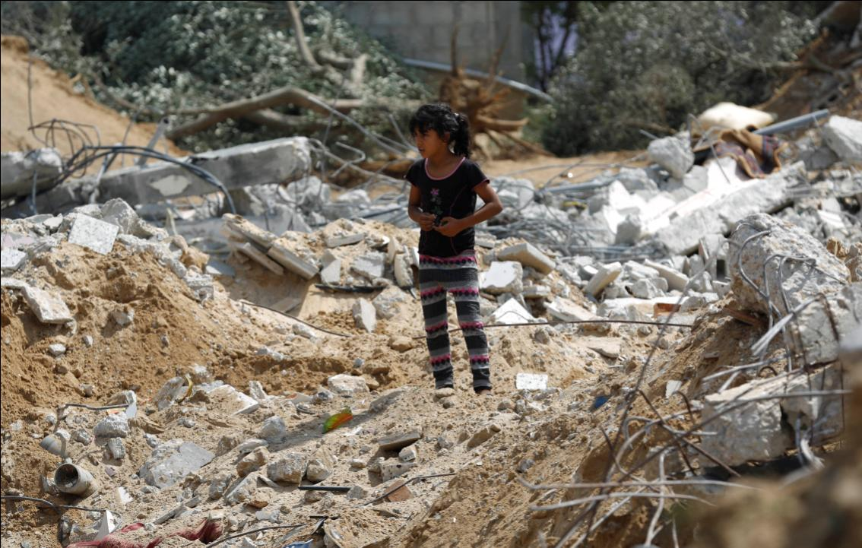


Overview of the
Humanitarian Situation in the oPt

Slide 2
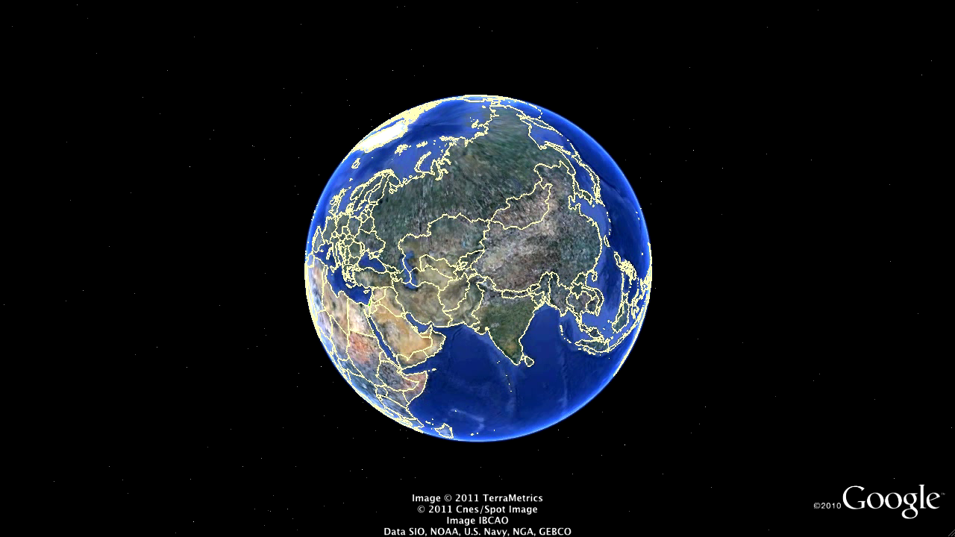
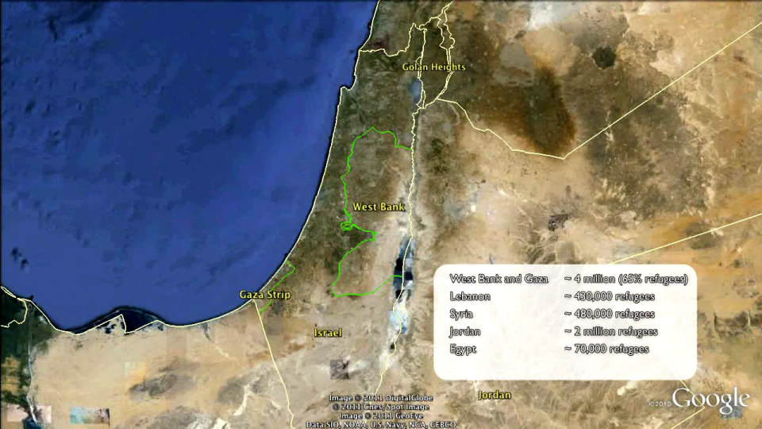
Notes:
KEY MESSAGE: West Bank and Gaza are separated; both are occupied; only 40% of the population lives in oPt – rest abroad, most as refugees.
When we talk about the oPt we are only referring to the West Bank and the Gaza Strip. They are separated from Israel by the 1949 Green Line (concluded after the 1947-1948 Arab-Israeli War)
When looking at the map, a few things are worth noting:
Less than 40% of the Palestinian population (2,9 out of 10,6 million) lives within oPt; more than 60% live abroad, most of them as refugees. This includes large refugee populations in neighbouring countries, such as Lebanon, Jordan and Egypt. These people, more than 62% of the Palestinian people, constitute the largest and longest-standing refugee population in the world.
These are not borders; they are armistice lines. However, they separate and divide the Palestinian population; note that there is no territorial connection between Gaza and the West Bank, that East Jerusalem is increasingly being separated from the remainder of the West Bank.
The entire area (both Gaza and the WB) is considered to be occupied territory; as the occupying Power, Israel has an obligation to administer its occupation in line with international humanitarian and human rights law. While Israel disputes that, this is the uniform position of the UN and most States in the world.

Slide 3
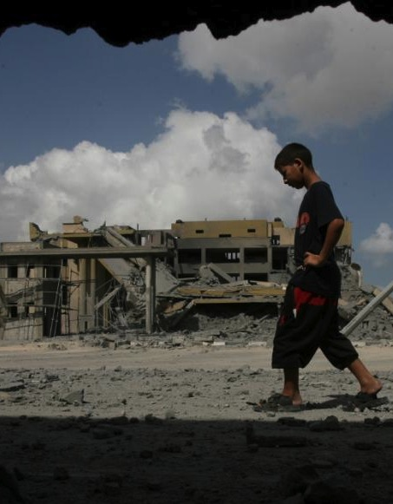
The Humanitarian Situation in oPt
Threats to life, liberty and personal security
Loss of land, homes and livelihoods – forced displacement
Restricted movement and access to services /assistance
Protection Crisis
Denial of basic rights and
lack of respect for international law
Notes:
KEY MESSAGE: There is a Protection Crisis, with serious negative humanitarian consequences
1. The key humanitarian issues:
Threats to life, liberty and security
Loss of land, homes and livelihood, frequently leading to forced displacement.
Restrictions on movement and access to services and assistance
These issues affect people throughout the oPt on a daily basis. The result: pervasive insecurity, poor and degrading living conditions; reduced standard of living and dependency on humanitarian aid, as well as overall lack of development (even ‘de-development’) in key areas.
What do these have in common? They are the result of a protection crisis, that has serious and negative humanitarian consequences! The humanitarian situation is brought about by a failure to respect and protect the basic rights of people, as enshrined in international law, both international humanitarian law and human rights law.

Slide 4
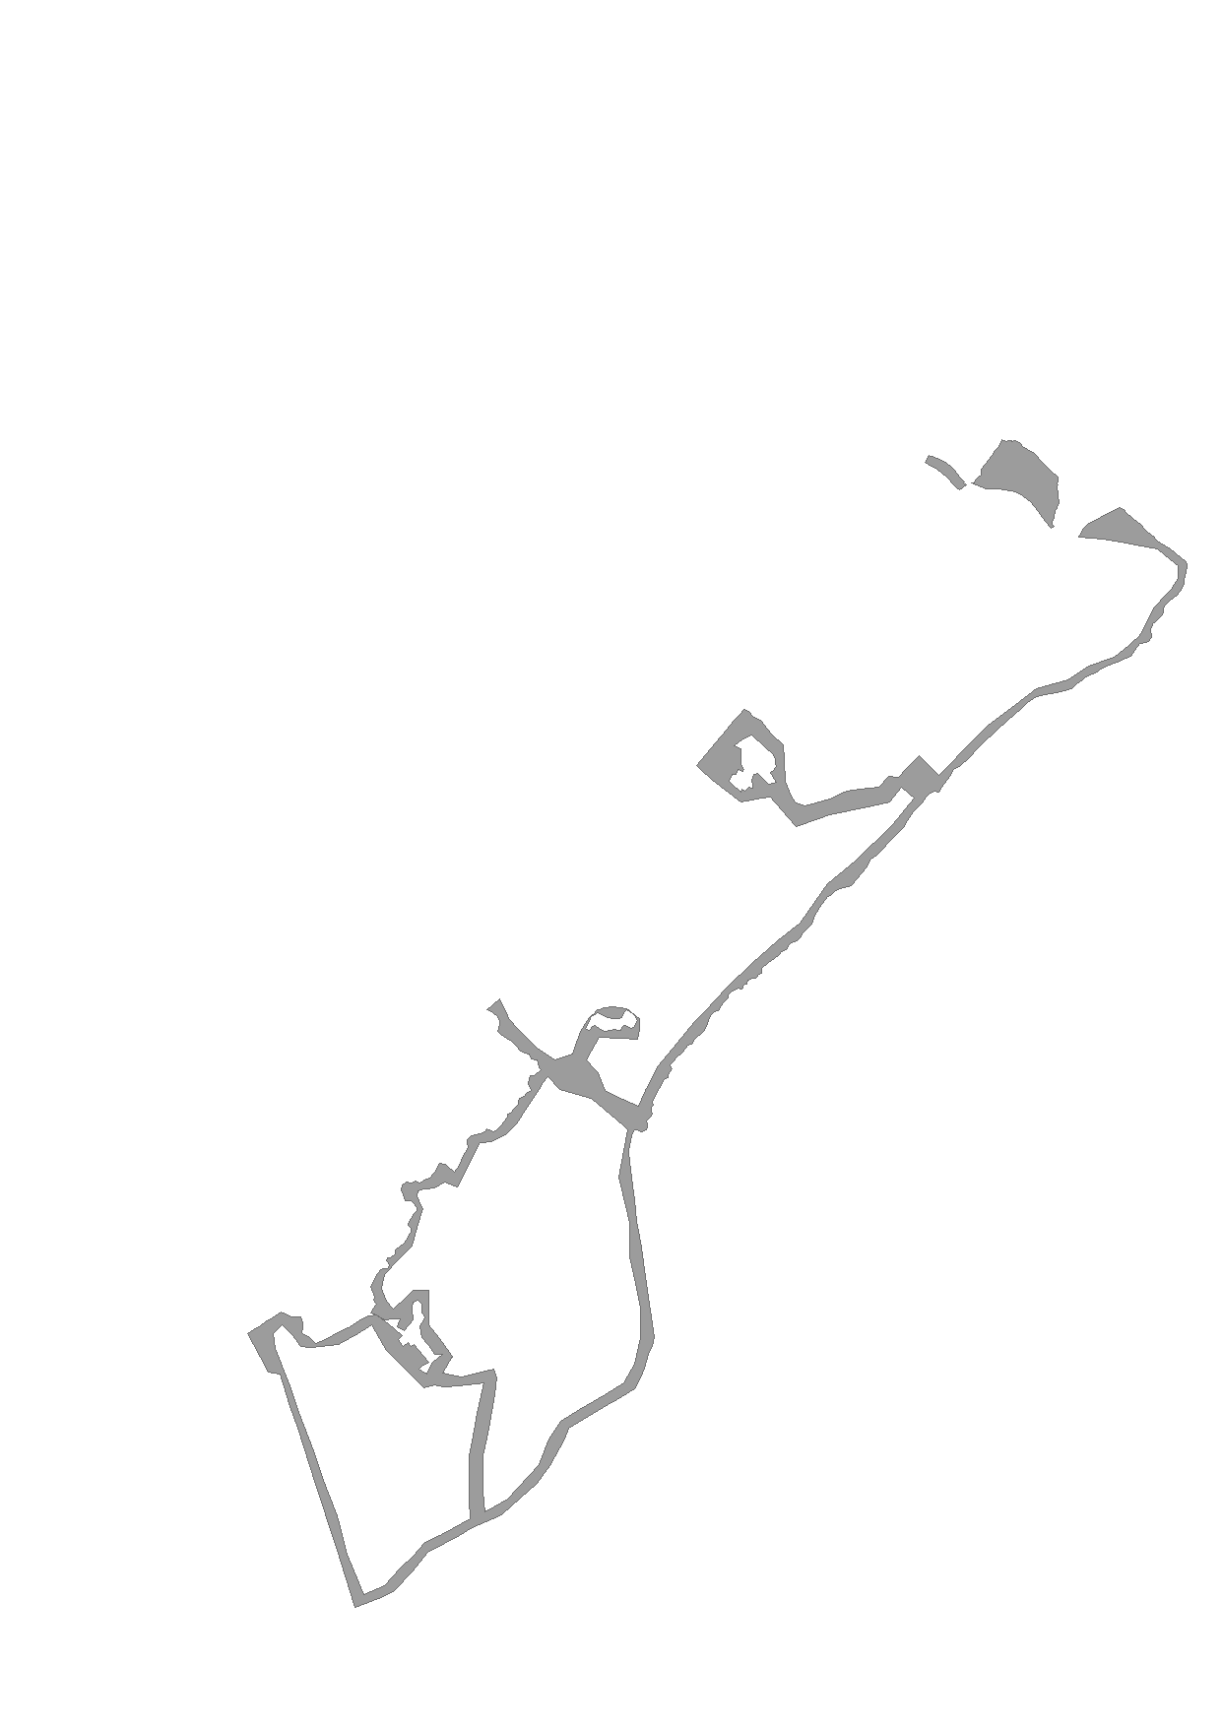
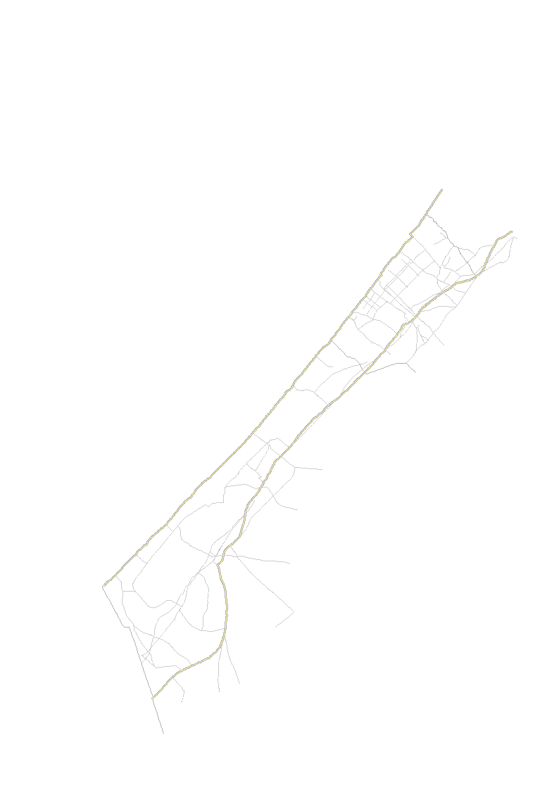

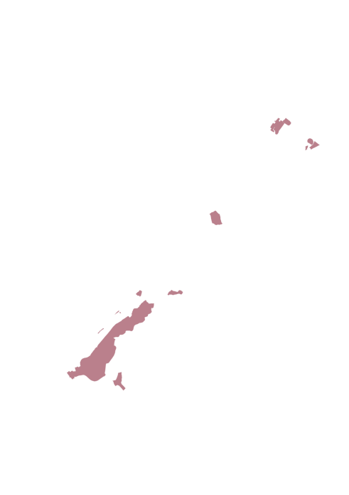

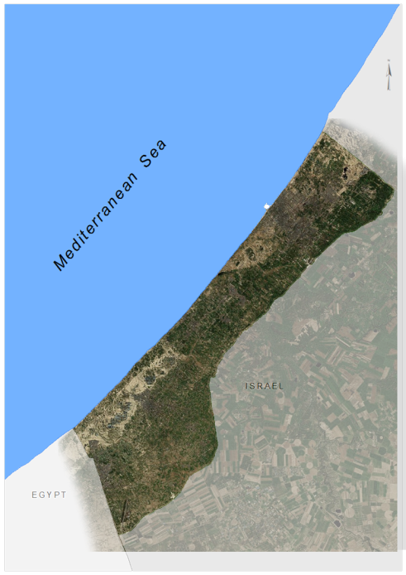
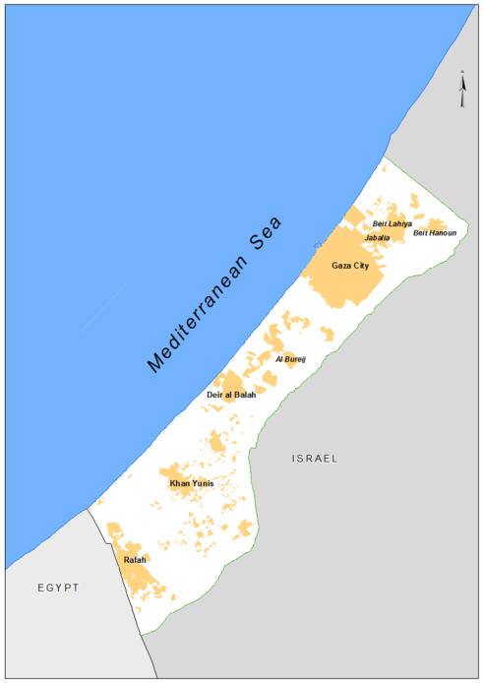

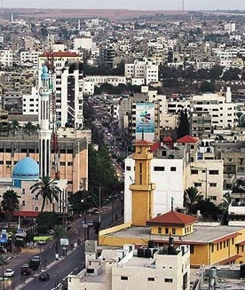
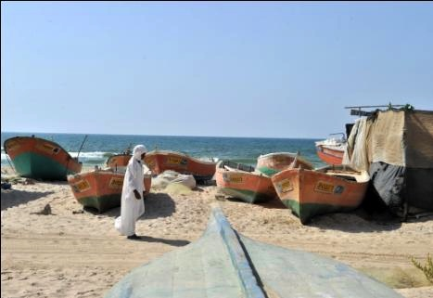
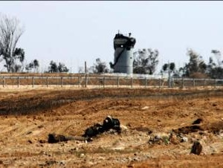
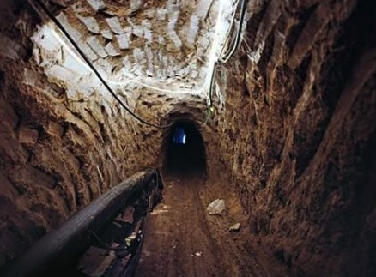
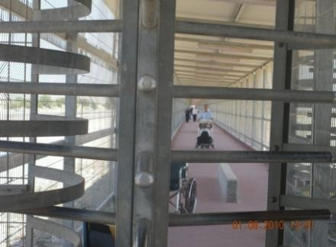
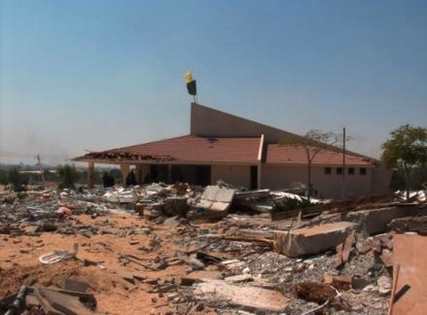
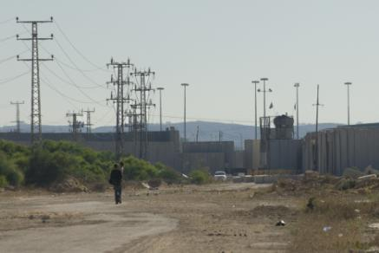
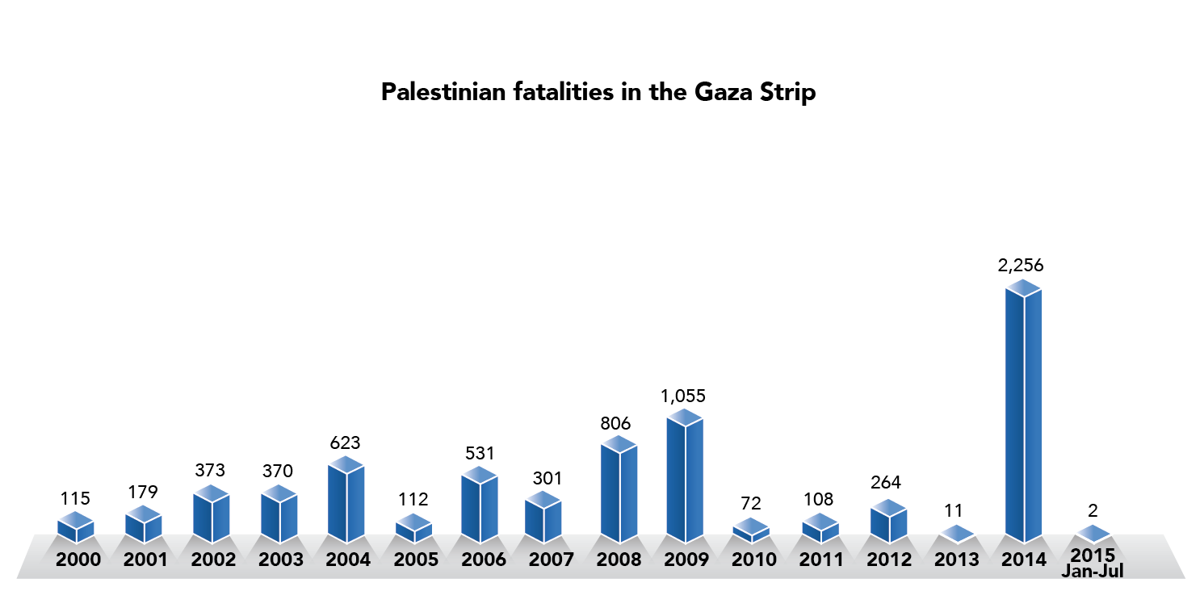

Gaza Strip
Erez
Crossing Point
0 - 100 meters: "no go" zone
Nahal Oz
Crossing Point
Karni
Crossing Point
Movement and access highly restricted
Source: The Economist
9,000 settlers and 21 settlements
15% of Gaza Strip
70% of fishing areas off-limits
3,500 fishermen, down from 10,000 (Sept. 2000)
1.8 million (70% refugees)
~4,500 persons km²
54% under 18
Tunnels
Fence
ARA
Crossings
Sea restrictions
Map
Rafah
Crossing Point
Tunnels
Settlements (pre-2005)
Sufa
Crossing Point
Fatalities
Exports
People Rafah
People Erez
Kerem Shalom
Crossing Point
Gaza hostilities
IDPs
Family fatalities
Notes:
KEY MESSAGE: The people of Gaza are subject to far-reaching and severe restrictions on land, air and sea. These restrictions are aimed at breaking Hamas, raising concerns about collective punishment.
BASICS: Borders with Israel and Egypt; small territory; large population; mostly young, many refugees.
BLOCKADE: Since 2007, but restrictions started as early as 1990s. Since then movement has been gradually restricted on land, air and sea, particularly in 2000, 2005 and 2007.
Fence & Crossings: A 6-8 m high wall/fence Gaza along the ‘border’ with Israel; a fence along the border with Egypt. Given that no one leaves the Strip on air or sea, the people of Gaza are effectively ‘locked in’. There are only a handful of crossings:
Erez: The main crossing intended for the movement of people. Selected categories, i.e. foreign humanitarian and diplomatic staff, and a limited number of Gazans that have obtained permits from Israel (mostly to seek medical aid abroad).
Nahal Oz: Mostly for fuel, closed for the most part since Dec 2009.
Karni: Closed for the most part in June 2007; remaining conveyor belt closed in Feb 2011.
Sufa: Mostly for aggregates, closed in Sept 2008, only opened on a few occasions, e.g. in April 2011 for a backlog of materials.
Kerem Shalom: The main crossing for import and export, including humanitarian goods.
Rafah: For people. Open 5 days (previously 2-3) a week for specific groups, i.e. students and patients, that have obtained a permit.
Tunnels: Around 200 – 300 tunnels operational on regular basis (as of April 2011). This includes 85 tunnels dedicated to the import of construction materials (aggregates, cement, steel bars), amounting to over 80% of the total of imported construction materials (around 100,000 metric tons). In addition to the external restrictions, there are also many restrictions on access to land and sea within the Gaza Strip and its territorial waters:
Restrictions on sea: 85% of fishing areas / 65,000 people affected
Restrictions on land within the Strip: no-go zone 0-500 meters (declared for 300 m) / high risk zone 500 – 1500 meters / 17% of the Strip / 35 % of agricultural areas / 113,000 people affected / value of land and property destroyed (replacement value) USD 300 million / yearly loss of over USD 50 m per year.
IN SUM: While Israel sometimes refers to security, has also acknowledged that the blockade is part of ‘economic warfare’, with the goal of removing Hamas from power. The blockade has been characterized as ‘collective punishment’ by the UN, which is prohibited under international law.

Slide 5
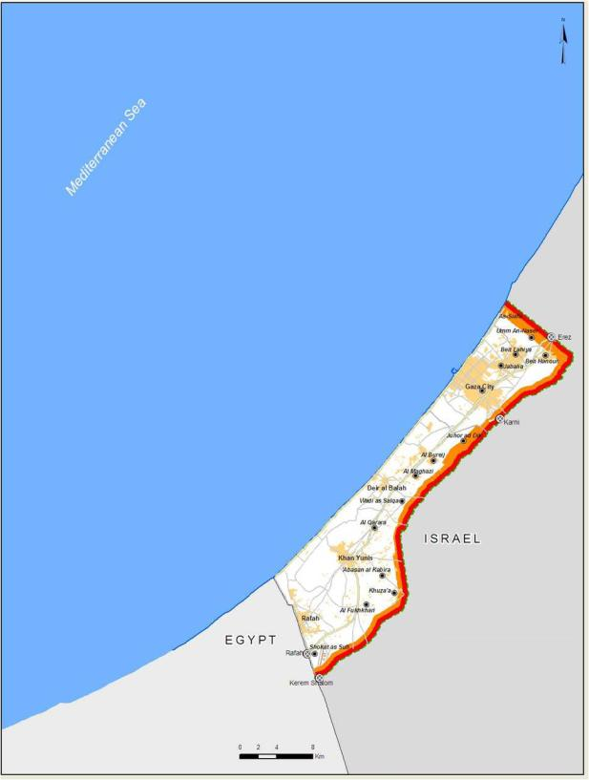
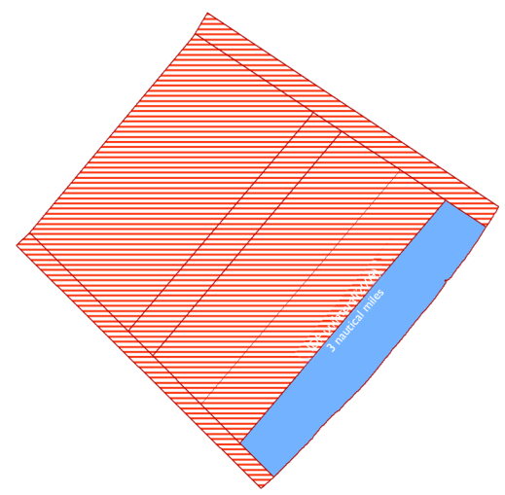



Back to main Gaza map
Notes:
Press → to advance layers
5

Slide 6
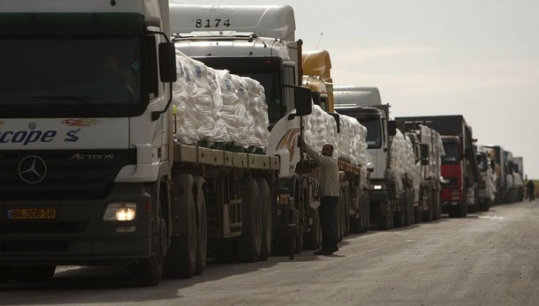
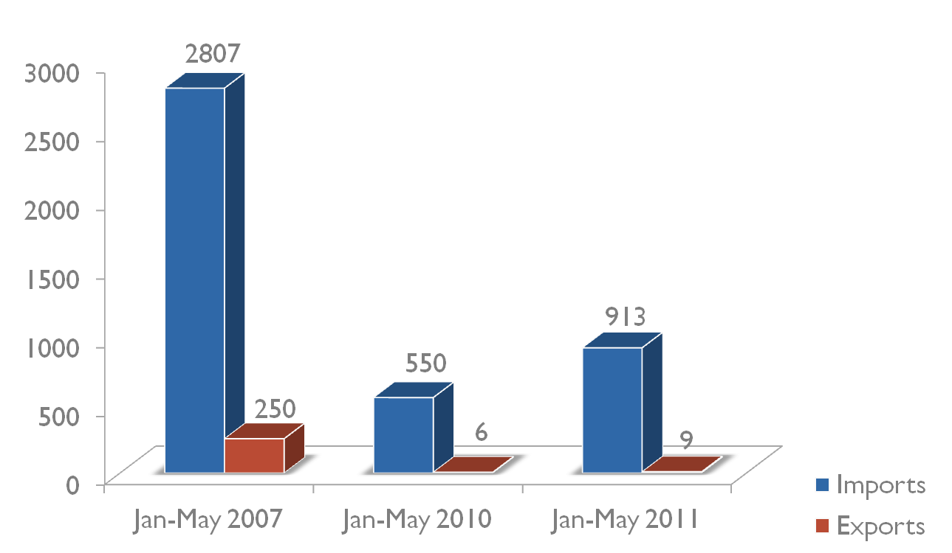
Recent Easings
  In June and December 2010
  Partial easing of import restrictions and increased exports
    from a list of permitted to banned or ‘dual-use’ items
  Approval of projects for international organizations
  Expansion of land crossings
  On the ground
  Increase in consumer products
  Further approvals needed for international projects
  Kerem Shalom crossing expanded – Karni crossing closed
  Limited exports
Truckloads imported/exported per week to Gaza
Maximum capacity of Kerem Shalom 300/day
No exports since May 2011
Notes:
KEY MESSAGE: Israel has recently “eased” the blockade. These changes, while welcome, have not lead to significant improvement and fall short of what is urgently required (which is to lift the blockade, not ease it). This includes both import and export, as well as movement of people.
From a list of banned items to a list of banned or dual use items → IMPACT: Increased import of consumer goods, but still only 40% of pre-blockade volumes. List of dual use items is broad and includes many basic items needed for reconstruction (e.g. pipes for water projects, printers, etc.)
Approval of international projects → IMPACT: Around 120 projects approved, but only a fraction of the need, which has been building up for decades. Also 1) The approval process remains difficult (comprehensive technical plans, specifications and schedules required) and 2) difficult monitoring regime (supervision from entry to use). Only 12% of UNRWA’s projects have been approved; would take 45 weeks of solid working to get the material imported.
Expansion of land crossings → IMPACT: Kerem Shalom has been expanded; however, other crossings have closed (Karni in February). Effectively only 1 crossing, which has raised cost (20%) + serious concerns if the crossing closes (like in April). There must be a plan B.
Increased exports → IMPACT: Very limited increase, only around 4 truckloads of day (strawberries, flowers and peppers).
Medical / Humanitarian access → IMPACT: Slight improvement in medical referrals for Gazans, but decline in access for humanitarian staff (from 76% to 63%).
IN SUM: While welcome, the “easings” have been limited and have not had a significant impact on the situation on the ground. The blockade must be lifted. To start with, humanitarian organizations must be able to import needed materials (including construction materials) and Gazans must be able to export.

Slide 7
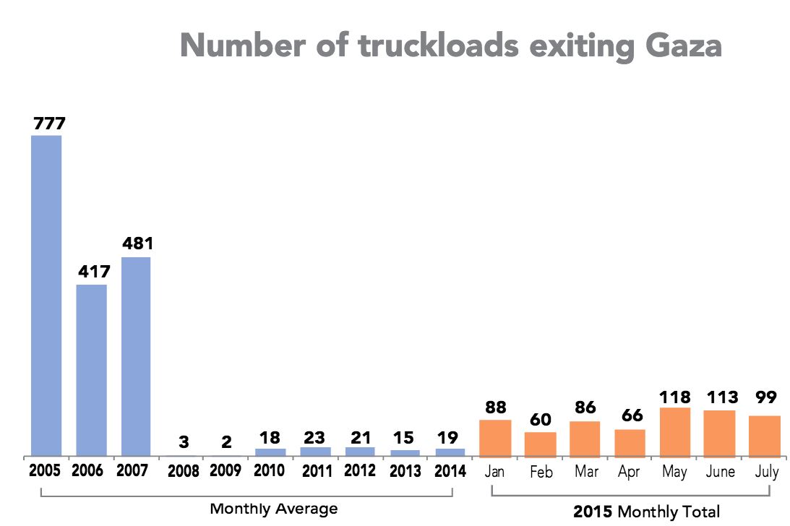
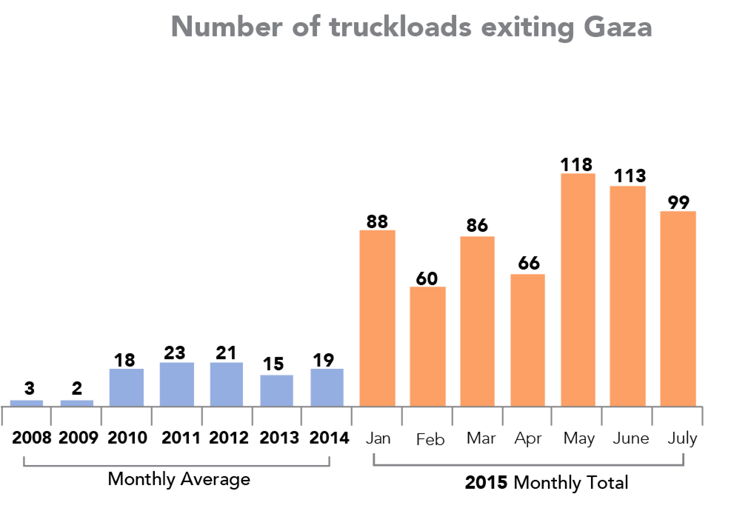
Kerem Shalom Crossing
Back

Slide 8
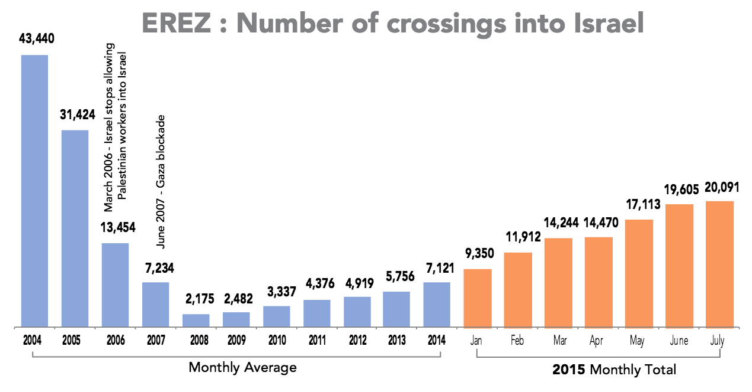
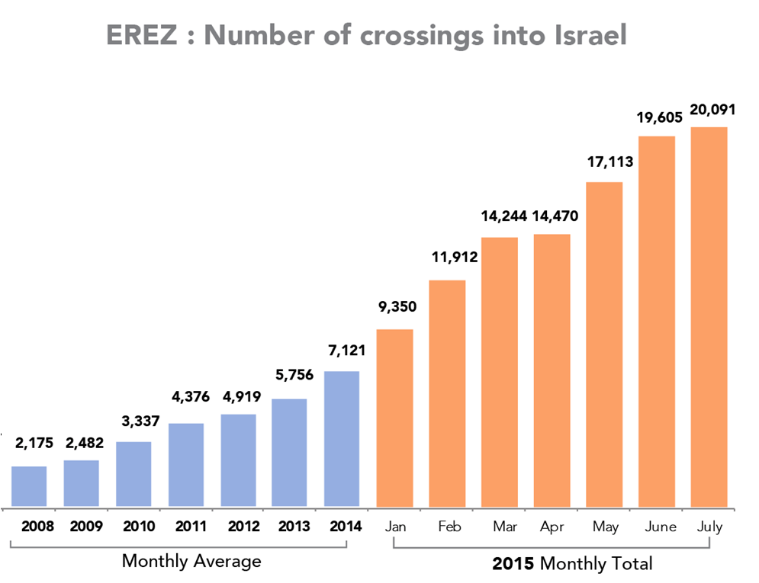
Erez Crossing
Back

Slide 9
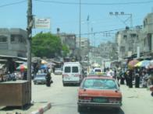
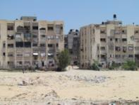
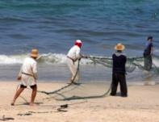

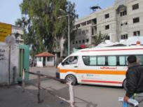
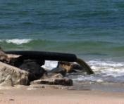
Population
2.13 million people /density 5,835 people per km² in 2020
Housing
71,000 housing units are needed in Gaza
Economy
Real GDP per capita US$ 1,273 in 2015, still less than in the 1990s
Education
250 additional schools needed now and another 200 by 2020
Health
Needed by 2020:
700 additional beds, 1,000 doctors and 2,000 nurses
Water
Aquifer unusable by 2016, irreversible damage by 2020: 60% increase in water demand

Slide 10
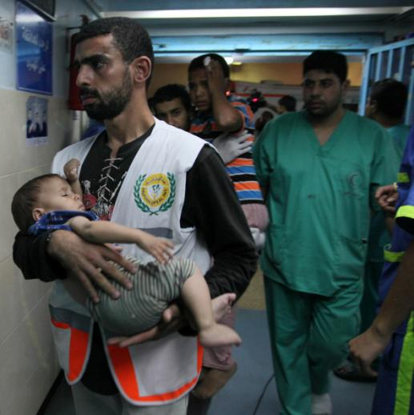
Widespread Protection of Civilians concerns
Over 1,500 Palestinian civilians killed (out of a total of nearly 2,200)
  520 children and ~290 women; ~140 status unknown
~ 11,000 Palestinians injured (Pal MoH)
Five civilians in Israel killed (of 71 total), dozens injured
Serious concerns over violations of IHL, inc. principles of distinction, proportionality and precautions in attack (e.g. targeting of homes, targeting civilian areas and infrastructure, attacks on UN facilities, inc. shelters, etc.)

Slide 11
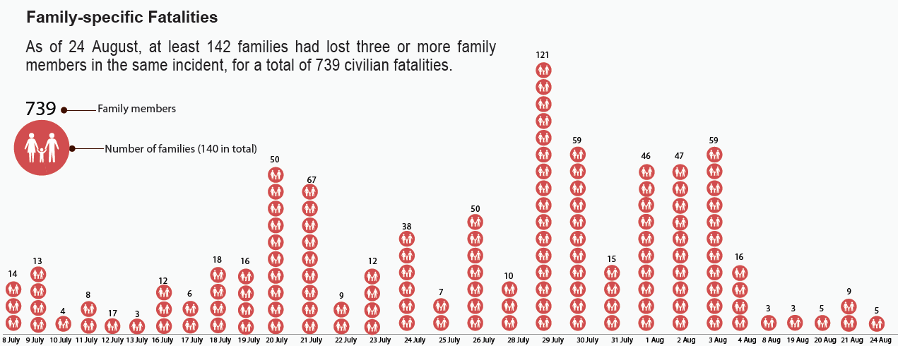
Back

Slide 12
Over 500,000 IDPs at height of crisis
Highest levels of IDPs since 1967
270,000+ hosted by UNRWA; 30,000+ in Gov’t shelters; others with host families
Shelters far beyond capacity
Over 100,000 lost their homes and will be IDPs long-term
Back

Slide 13
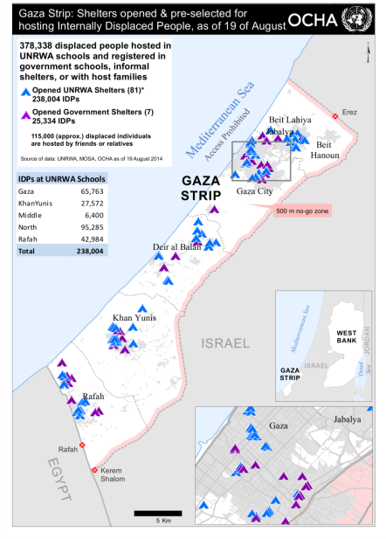

Slide 14
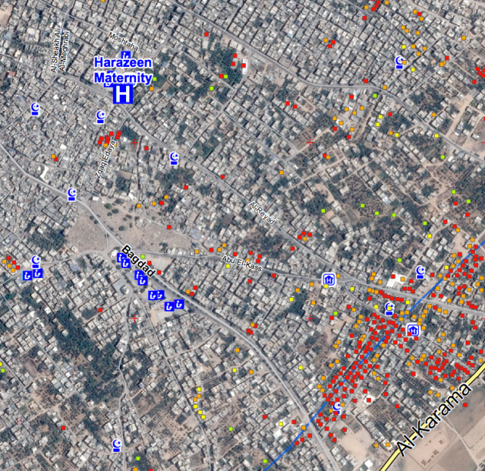
Massive Damage to Property and Infrastructure
~20,000 houses destroyed or severely damaged
~75 hospitals and clinics damaged
GPP shut down
Water and electricity networks damaged
~100 UN facilities damaged, inc. shelters
Red = Destroyed
Orange = Severely damaged
Yellow = Moderately damaged
Image: Ash Shuja’iya, Gaza city

Slide 15
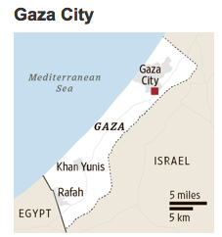
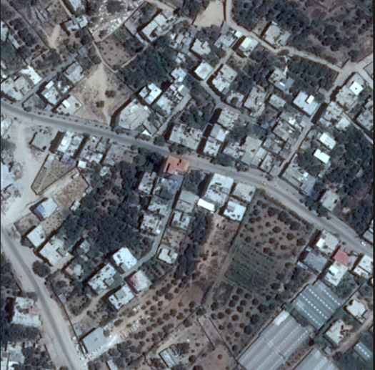
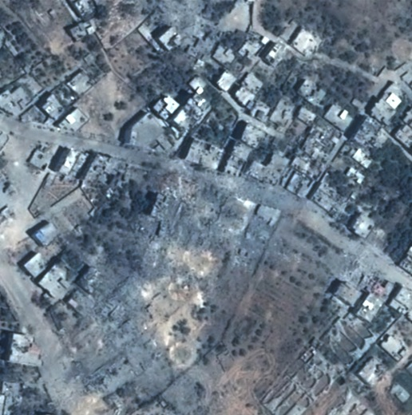
Before
After

Slide 16
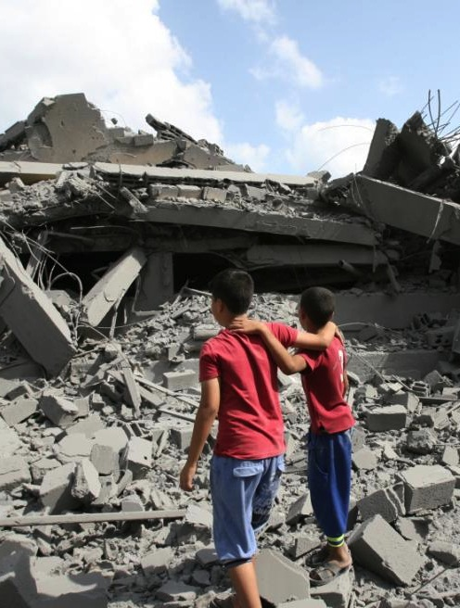
Way forward
Durable ceasefire that addresses root causes, inc.
  - End of blockade
  - End of rocket fire
Accountability
Opening of Rafah Crossing
Consolidation of GNC
Strong mobilization of resources

Slide 17
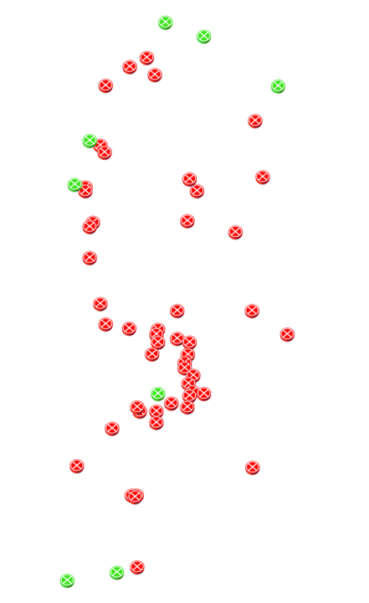
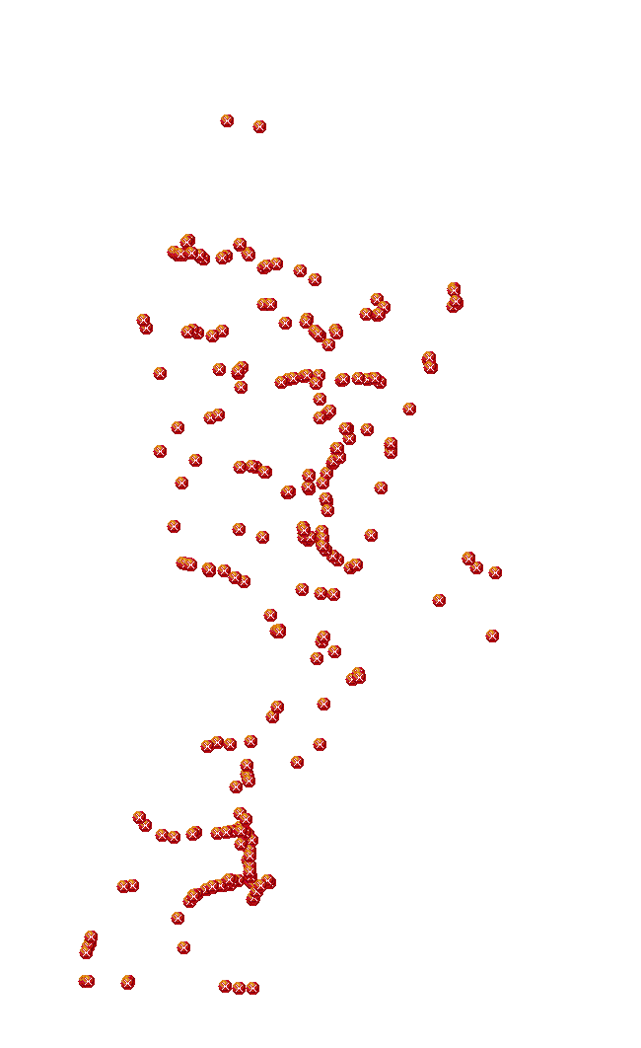

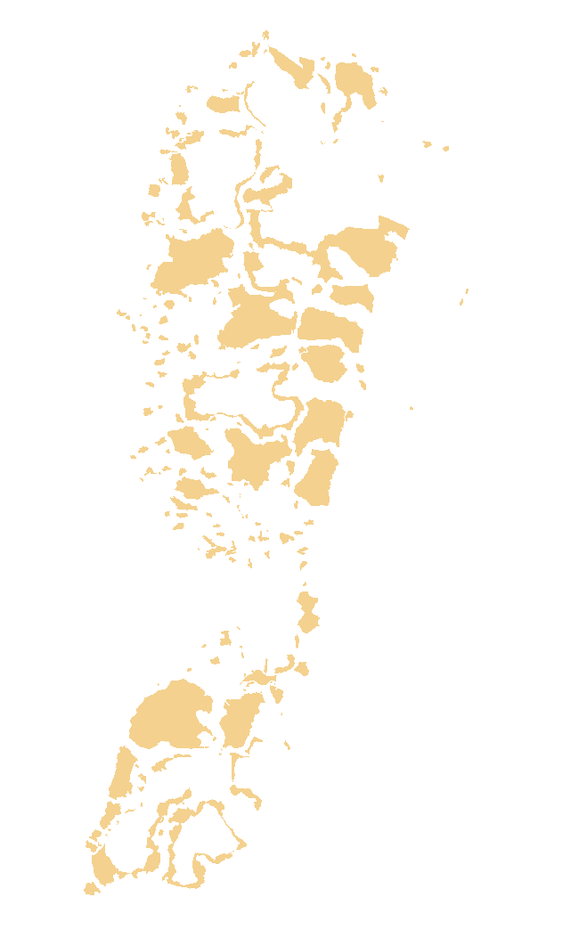
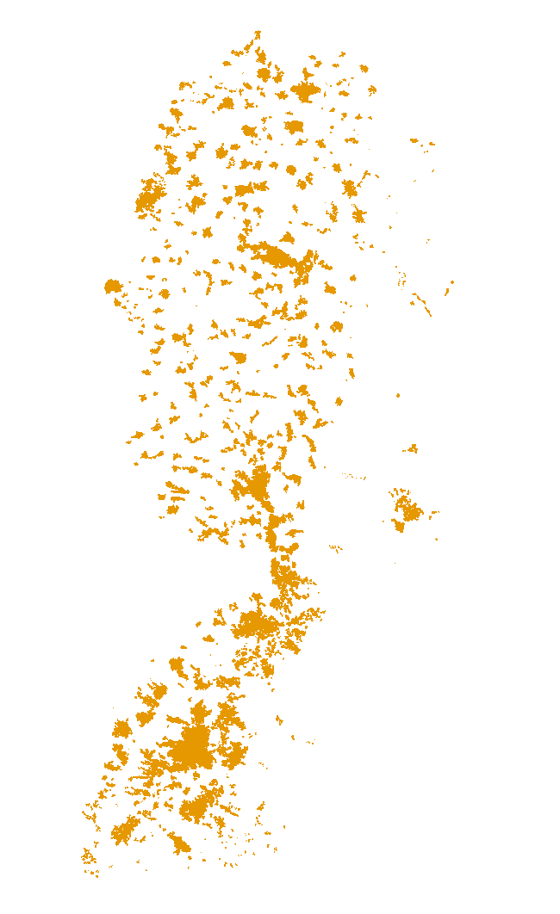
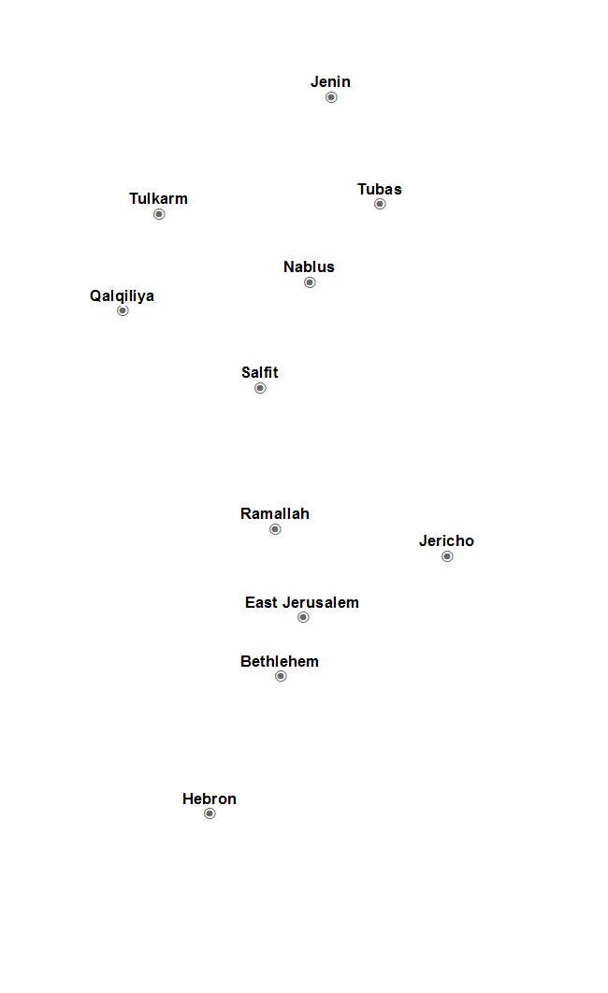
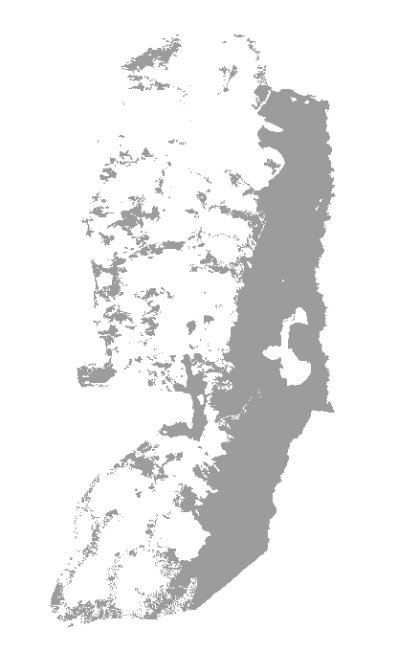
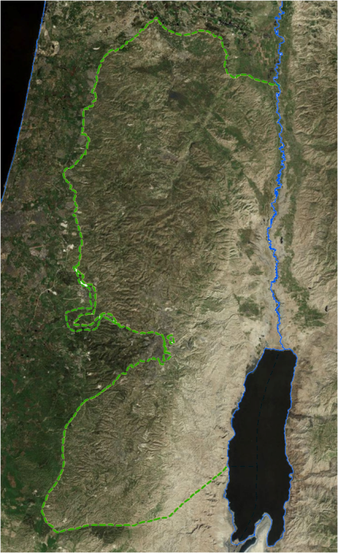
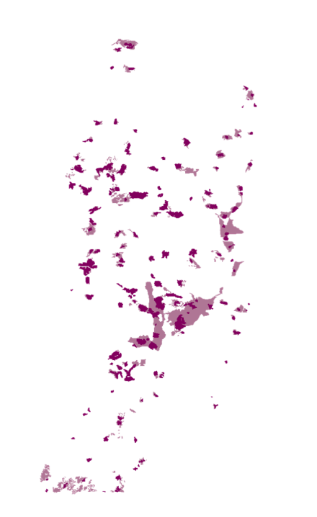
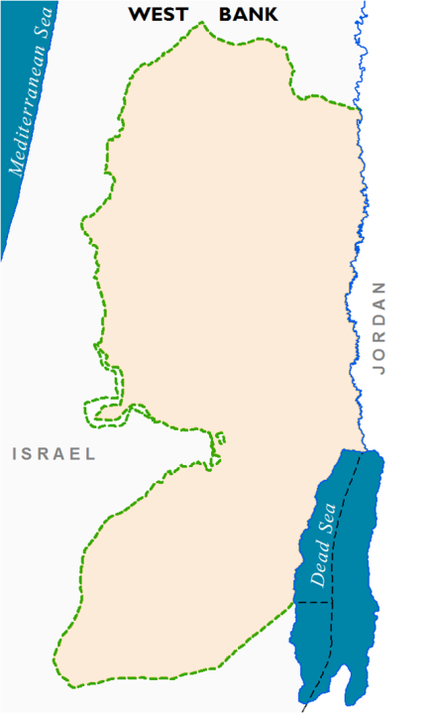
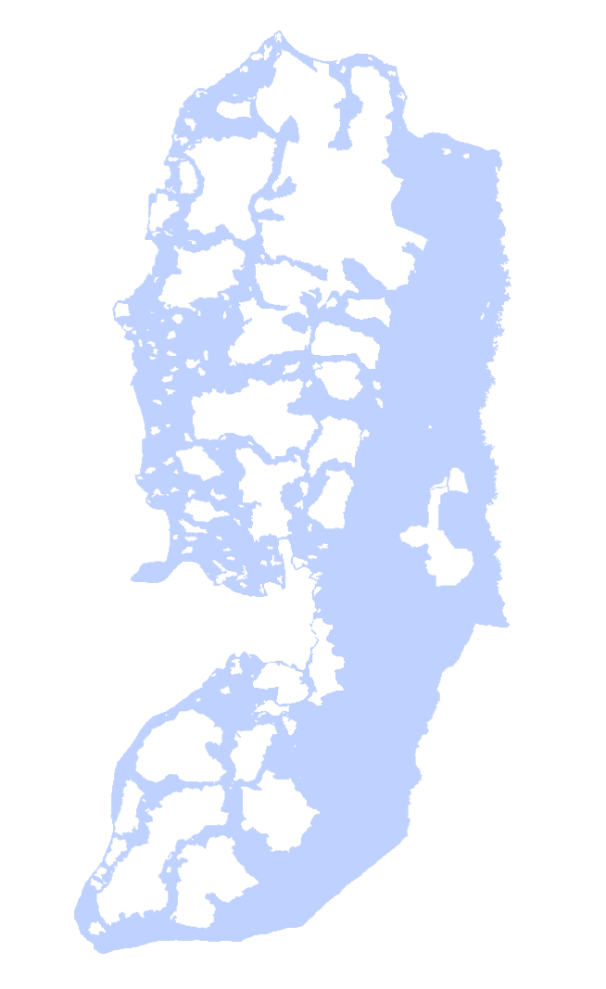

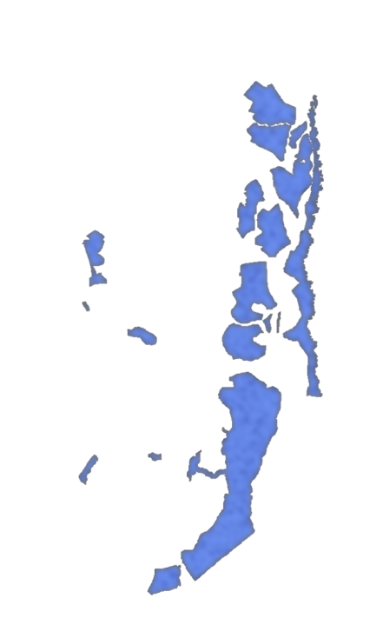
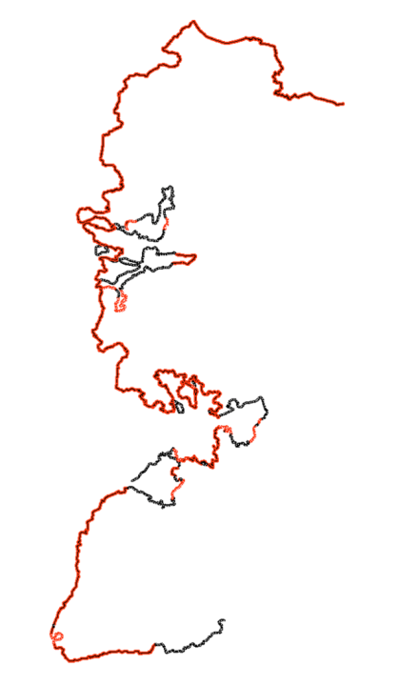















Palestinian casualties by Israeli forces in the West Bank: concerns about excessive use of force
Settlements’ local & regional councils
Land use subject to ICA approval
Reserves for settlement expansion
Off limits for Palestinian development
Area: 2,400 km2, 42.7% of the WB
18% of West Bank
Approx. 700km – 85% in West Bank
Less than 40% of West Bank
80% of Palestinians
More than 60% of West Bank
~300,000 Palestinians
490 closures, including 60 checkpoints
~150 settlements and 100 outposts
556,000 Israeli settlers
5,600km²
2.7 million Palestinians
10% of West Bank
Palestinian Communities
Nature reserves
Bedouin relocation
Areas A and B
Barrier
Qalqilia
Area C & Wye River Nature Reserves
Shrinking Space
Casualties
Settlements (outer limits)
Closures
Anatot
Settlements (municipal)
Military zones
Demolitions
Settlements (regional councils )
Settler violence
Settlements trends
Notes:
KEY MESSAGE: The civilian population in the West Bank is subject to a complex and multi-layered system of control, which severely restricts Palestinian movement and their ability to use and develop land and resources.
BASICS: West Bank is the area east of the Green Line, down to the Jordan border. Larger than Gaza, but still relatively small. Has 2,5 m Palestinians, around 30% of them refugees.
CONTROL REGIME: The West Bank is subject to a complex and multi-layered system of control, which severely restricts Palestinian movement and their ability to use and develop land and resources. This includes:
Division into separate areas, i.e. Areas A (full Pal control): B (Pal civil control/Isr security control; C (full Israeli control) and Jerusalem (annexed into Israel). This division was agreed upon in the Oslo Accords. For example, Area C, which is under full Israeli military control, amounts to 60% of the West Bank and is the only contiguous area in the West Bank, holding major land reserves necessary for livelihoods and development. More than 150,000 Palestinians live in this area. Also, Jerusalem is cut off from the WB; Pal from WB need special permits to access the city.
Israeli settlements: Around 500,000 settlers in around 150 settlements and 100 settlement outposts. They are illegal under international law. Have however continued to expand, with the settler population doubling in the last 20 years (if one excludes EJ, it has tripled). What the map does not show, is the regional area of the settlements, which covers 40% of the West Bank, 40 times the area you see here.
Closed military zones: Areas that are declared “firing zones” by Israel and where Palestinian presence is prohibited. Covers 18% of West Bank.
Nature reserves: Covers 10% of the West Bank, Palestinans are not allowed to use or the develop the land (3% of this was to be transferred to PA under the 1998 Wye River Accord, but never took place).
In addition to restrictive zoning and planning, there are a number of physical and administrative obstacles in the West Bank:
Closures: Over 500 checkpoints, roadblocks, fences, trenches and the like (also flying checkpoints, averaging around 90 a week). All located within the WB; not on the Green Line, intended to protect the settler population and control Pal movement → TREND: Decreased number since 2009, improved movement between population centers, but reduced access to land/resources, Jordan Valley and East Jerusalem.
Barrier: The largest “closure”. Over 700 km long (60% constructed), dividing and isolating Pal communities and “annexing 9,5% of the West Bank (taking in 85% of the settler population). Comes in two forms: 6-8 m high concrete slaps or system of fences. Problem is the route; Israel has the right to defend its citizens, but must respect int’l law. ICJ declared the parts within the Green Line illegal and ordered Israel to dismantle or reroute it, and compensate those affected.

Slide 18

Settlement expansion and consolidation
Building starts (housing units)
Source: Israeli Central Bureau of Statistics

Slide 19
Settlement expansion and consolidation
Tenders (housing units)
* Including East Jerusalem
Source: Peace Now

Slide 20

Settlement expansion and consolidation
State land declarations/ratifications
(“blue line” team), 2013-2014:
~ 40,000 dunums
~ 50 sites
“Legalization” of unauthorized settlement outposts:
- 13 completed
- 12 in process
Back to WB map

Slide 21

West Bank demolitions and displacement
* Source: OCHA

Slide 22
Donor funded structures demolished
* Source: OCHA

Slide 23
Donor funded structures issued demolition or stop-work orders
* Source: OCHA

Slide 24

581 Orders ready for execution
Demolition Orders against
Palestinian structures in Area C:
1988-2015
14,477
Demolition Orders
Issued
11,425
Demolition Orders
Outstanding
* Source: Israeli Civil Administration
Back to WB map

Slide 25





























Occupied East Jerusalem
Sheikh Jarrah
Al-Kurd
839 structures demolished since 2000
1,500 orders outstanding
86,500 people at risk
~130 evicted in 2009/2010
At least 500 at risk
Ghawi
Jerusalem ID holders on the WB side of Barrier
~ 55,000 affected
142 km (4 km on the Green Line)
Illegal according to the ICJ
~ 270,000 Palestinians with permanent residency
Over 14,000 revocations since ‘67
17 Checkpoints – only 4 for WB Palestinians
~200,000 settlers (doubled since 1993)
Illegal under international law
16 Palestinian communities
~ 2,500 people affected
Hannoun
Kubbania Um Haroun
Armistice line (Green Line)
Israeli declared Jerusalem municipal boundary
OCHA Office
Palestinian communities
Closures
Settlements
East Jerusalem hospitals
Barrier
Demolitions
Silwan map
Settlement layers
Evictions
Sheikh Jarrah
Settlements 1987
Isolated communities
Dislocated communities
Settlements 2005
Notes:
CASE STUDY: EAST JERUSALEM
Order of buttons: Pal population – settlements – evictions – demolitions & barrier [together] – closures – isolated communities – dislocated communities
History and residency: Before 1967 Jerusalem was a small area (old city, plus holy basin); when Israel annexed the city in 1967 it expanded the municipal boundaries to take in 28 Palestinian villages and parts of Ramallah and Betlehem. In EJ, Israel thus applies its domestic law, not military law. The annexation runs counter to international law (the prohibition on acquisition of territory by force) and has not been recognized by the international community. The impact on the Palestinian population is however significant. Firstly, when EJ was annexed, the Palestinian residents were overnight turned into “foreigners” in Israel, that do not have citizenship but rather “permanent residency permits”. → Problems: 1) residency rights are frequently revoked, over 14,000 since 1967; 2) residency not extended through marriage, so mixed families live separately or “illegally” in EJ; 3) children of mixed marriages not registered (as many as 10,000)
Settlements: Since annexation Israel has constructed a number of settlements. The current settler population is 200,000, or 40% of the total population. This includes large government-built settlements, such as Pizgat Ze’ev and Maele Adummin, which continue to expand. In a worrying trend, private settler groups – with government support – are increasingly using organized and well-funded attempts to take over land and property in Palestinian neighbourhoods. They use various means for this purpose, including reclaiming land supposedly lost before 1948 (which Palestinians are unable to do); absentee property laws; and private purchase. The result: Forced evictions and displacement of Palestinians (many of them refugees) and growing fragmentation and tension in Palestinian areas.
Zoning and planning: Only 13% is zoned for Palestinian construction (35% for settlements) and it is difficult for Palestinians to obtain permits. The result is a severe housing crisis in EJ, with 32% estimated to be built without permits. This has resulted in frequent demolitions and displacement; since 1967, 2000 homes been demolished / In 2010, 74 structures (with additional 10 self-demolitions).
Barrier and Checkpoints: Over 142 km long / only 4 km on the Green Line. Main problems:
Severs EJ from the rest of the WB and restricts access by WB Palestinians to the city. They have to obtain a permit (mainly provided for medical reasons); can only cross on foot at 4 out of 17 checkpoints. Particular problems in terms of access to specialized health care, which is only available at 6 EJ hospitals.
Does not follow either the Green Line or the Municipal line. As a result, there are EJ-ID holders on the WB side (isolated communities) and WB-ID holders on the EJ side (dislocated communities). Examples:
Isolated communities: Include Shufat camp and Kafr Agab, all EJ-ID holders that have to cross checkpoints to get into the city. 55,000 affected. Fear that these communities will eventually be “cut out” of Jerusalem.
Dislocated communities: 16 communities, around 2,500 people (1,600 of them WB-ID holders). Example: Nabi Samuel, problems with access because they are cut off from rest of WB by Barrier, and do not have permission to enter Jslm. Are in Area C, so have no planning and zoning, and are at risk of demolitions.

Slide 26

19 May – demolitions wave hits 6 sites
Sateh al Bahr
28 Apr - eviction orders against families in a “firing zone.” 10 shelters and 5 mobile latrines funded by donors, at demolition risk.
Khan al Ahmar
23 Apr - HCJ hearing, State attorney confirms plan to transfer residents to Nuweimeh
Jabal Al Baba
23 Feb - stop work orders 18 donor funded caravans
12 Mar - 1 house demolished, 10 people displaced.
3 Apr - 6 structures demolished, 31 people displaced.
9 Apr - final demolition orders 18 caravans; 3 three disassembled and seized.

Slide 27


Bedouins’ forcible transfer
Fasayil
2 plans
201 plots
awaiting pre-publication discussion
An Nuwei’ma
4 plans
1,140 plots
objection stage completed
awaiting final endorsement
Al Jabal
2 plans
One plan (48 plots) approved
One plan (240 plots) awaiting pre-publication discussion
Back to WB map

Slide 28





Palestinian built-up areas:
557 localities
~400 km2,( 7% of the West Bank)
Population (mid 2012): 2.6 million
730,000 registered refugees (28 %)
Settlements outer limits :
~150 recognized settlements
~ 100 ‘unauthorized’ outposts
Population (end 2011): 520,000
Fenced or patrolled areas
Area: 173 km2, 3% of the WB
Settlements’ Local & Regional councils
Land use subject to ICA approval
Reserves for settlement expansion
Off limits for Palestinian development
Area: 2,400 km2, 42.7% of the WB
~150 settlements and 100 outposts
500,000 Israeli settlers
5,600km²
2.5 million Palestinians
Palestinian communities
Outer limits
Municipal boundaries
Chart
Regional Councils
Outposts

Slide 29






Seizure of land
As a result of the expansion of the
settlement the lands were gradually
abandoned due to the limitations of access
The Settlement of Anatot (Almon), 1997
Old Gate
The Gate of the Settlement
New Gate
Old Gate
New Gate
In 2004 the gate was
moved 720 m. to the West
A new fence was
erected illegally
Some 195 dunums (48 acres) of private
Palestinian land were trapped in the settlement
In 2002 a new neighborhood is added
Another 460 dunums (114 acres) of private
Palestinian land were trapped in the settlement
Back

Slide 30




The Humanitarian Situation in the West Bank
Loss of land, homes and livelihoods → forced displacement
Area C
East Jerusalem
1% Construction
allowed
Palestinian construction
9.2 km²
Israeli settlements 24.5 km²
Restricted
Last 10 years:
Over 4,000 displaced
2009 – 2012
Increase 123% structures / 43% people
Residents forced to move to Areas A and B
Multiple reasons for displacement
Unplanned areas
21.4 km²
Green and public
areas 15.5 km²
Construction prohibited
Planning restrictions
Map
Notes:
KEY MESSAGE: The multi-layered system of control enforced by Israel in the West Bank has a severe impact on Palestinian communities, giving rise to humanitarian needs.
LOSS OF LAND, HOMES AND RESOURCES → DEMOLITIONS
Severe restrictions on zoning, planning and building make it impossible for the population in Area C to build homes, maintain their livelihoods or develop their communities. More seriously, they also give rise to demolitions of Palestinian homes and sources of livelihood. In 2010, more than 431 structures were demolished in the WB, displacing over 600 people, half of them children. Over 4,000 people displaced in this manner in the last 10 years. Impact includes loss of shelter; reduced access to water/sanitation and education, increased poverty and dependency on aid.
According to Israeli authorities, demolitions are only carried out against structures that do not have building permits and are therefore “illegal”. The reality, however, is that it is extremely difficult for Palestinians to obtain such permits:
Area C Graph: Only 1% of Area C is available for Palestinian construction, much of it built up already (70% taken for settlements, military areas and nature reserves / 29% formally allowed, but off-limits in practice). At least 3,300 outstanding demolition orders.
EJ Graph: Only 13% zoned for Palestinian construction, much of it built up (35% taken for settlements; 30 not planned; 22 green or public areas). Various restrictions on permits, e.g. infrastructure requirements and limited plot ratios. Around 32% of homes estimated to be built without permits, placing 85,000 at risk. At least 1,500 outstanding orders.
.

Slide 32


2015 Humanitarian Needs Overview

Slide 33

2015 Strategic Response Plan
13th response plan for the oPt
Focus on Gaza Strip, Area C of the West Bank and East Jerusalem

Slide 34



2015 Strategic Response Plan
Current funding levels of the SRP:
(third largest request for oPt since 2003)

Slide 35

The Way Forward
Ensure respect for basic rights
Protect civilians and end impunity for violence – investigate all complaints of violations of rights
Bring displacement to an end, including by ceasing evictions and demolitions
Allow safe movement & unhindered access to services / assistance

Slide 36


The Humanitarian Situation in the West Bank
Loss of land, homes and livelihoods → forced displacement
Movement and access to services and assistance
  Education
  Health
  Water and sanitation
Livelihoods/economy
Physical insecurity
  ~500 killed & ~11,000 injured
  since 2005
118% increase in settler violence
2009-2012
    315,000 vulnerable (135,000 highly vulnerable)
    Over 90% of complaints closed
West Bank
Notes:
PHYSICAL INSECURITY
1. Military violence: WB is occupied territory under military command and military operations of various types occur on a daily basis. Main concerns relate to prolonged arbitrary arrest and detention and allegations of ill-treatment, even torture, while in detention. Also concerns about fair trial guarantees. Violence usually takes place with impunity. In a positive development, the IDF recently announced that they will start to conduct criminal investigations into killings of Palestinians, after a 10 year gap, but it must remain to be seen whether these will be effective.
2. Settler violence: Our main concern relates to violence, intimidation and harassment at the hands of settlers.
Is on the increase: in 2010, 476 incidents, represents X% increase since 2006. Includes physical attacks as well as damage to property (photos, with statistics, e.g. in 2010, more than 6,000 olive trees burned, uprooted, dried with chemicals or otherwise vandalized).
Most incidents (65%) occurred in the Nablus, Ramallah and Hebron governorates. In total, 83 communities (pop. 250,000 people) have been identified as being vulnerable to settler violence (22 of them/76,000 highly vulnerable). Around 26 road junctions and road segments likely to be targeted if tensions arise (e.g. as a result of evacuation).
Impunity! Settler violence takes place with near impunity, with few complaints being filed (e.g. owing to lack of trust in the Military Police). In addition, over 90% of filed complaints have been closed in recent years without indictment by the Israeli authorities (according to Yesh Din).

Slide 37

















Qalqiliya - Jayyous
55
Green Line
West Bank Barrier
Constructed
Planned
Dismantled
Palestinian
Built-up
Israeli
Settlements
Barrier Gates
Habla Tunnel
Jayyus’ Land
Road 55
Water wells
Back to WB map
0
1
2
Miles

Slide 38




Movement & Access Restrictions
HEBRON CITY (H2)
“The opinion that it is possible for Palestinians to live a normal life in the area alongside that of Israelis, is inconsistent with the principle of separation that underlies the security forces’ plan to safeguard the space.”
(Letter from IDF legal advisor, 31 January 2007)

Slide 39








EVICTIONS, DEMOLITIONS AND DISPLACEMENT
LIMITED ACCESS TO SERVICES
LIMITED ACCESS TO RESOURCES
LIMITED ACCESS TO LAND AND LIVELIHOODS
INABILITY TO DEVELOP COMMUNITIES
THREAT TO LIFE
CLOSED MILITARY ZONES
Ismaeel Al Adara, 65 years old, from Bir al Idd was attacked by two masked settlers while herding in the FZ918 in August 2012. Ismaeel sustained serious head injury and was transferred to hospital after his son (11 years, who witnessed the attack) managed to call for help. Ismaeel was discharged from hospital after 4 days of receiving treatment.
In FZ918 there is one school with facilities at 2 locations, both received demolition orders after being rehabilitated by international donors. Five communities have small scale solar systems for electricity. These facilities also received demolition orders.
In FZ918, there are no paved roads. Some are closed due to settlement activities, forcing people to use longer, rocky detours. The road connecting Jinba to road 316 received a demolition order after it was partially rehabilitated by international donors.
FZ918 area is around 30,000 dunums, of which about 12,200 dunums are cultivated. The average yearly produce of the land is about 93 tons of barley and wheat (average yearly consumption of fodder in the FZ918 is about 370 tons/year)
Limited access to land and livelihoods
Limited access to resources
Limited access to services
In FZ918 there are currently 50 different residential and livelihood related structures with demolition orders, most of them in Jinba.
In FZ918, international donors funded the construction and renovation of 155 cisterns, at least 25 of them have received demolition orders.
Inability to develop their communities
Evictions, demolitions and displacement
Threats to life, safety and security

Slide 40

East Jerusalem
800 structures demolished since 2000
1,500 orders outstanding
86,500 people at risk
~130 evicted in 2009/2010
At least 500 at risk
Jerusalem ID holders on the WB side of Barrier
~ 55,000 affected
142 km (4 km on the Green Line)
Illegal according to the ICJ
~ 270,000 Palestinians with permanent residency
Over 14,000 revocations since ‘67
17 Checkpoints – only 4 for WB Palestinians
~200,000 settlers (doubled since 1993)
Illegal under international law
16 Palestinian communities
~ 2,500 people affected
Armistice line (Green Line)
Israeli declared Jerusalem municipal boundary
Palestinian communities
Closures
Settlements 1987
East Jerusalem hospitals
Settlements 2005
Demolitions
Barrier
Evictions
Settlement layers
E1 settlement project
Isolated communities
Dislocated communities
Notes:
CASE STUDY: EAST JERUSALEM
Order of buttons: Pal population – settlements – evictions – demolitions & barrier [together] – closures – isolated communities – dislocated communities
History and residency: Before 1967 Jerusalem was a small area (old city, plus holy basin); when Israel annexed the city in 1967 it expanded the municipal boundaries to take in 28 Palestinian villages and parts of Ramallah and Betlehem. In EJ, Israel thus applies its domestic law, not military law. The annexation runs counter to international law (the prohibition on acquisition of territory by force) and has not been recognized by the international community. The impact on the Palestinian population is however significant. Firstly, when EJ was annexed, the Palestinian residents were overnight turned into “foreigners” in Israel, that do not have citizenship but rather “permanent residency permits”. → Problems: 1) residency rights are frequently revoked, over 14,000 since 1967; 2) residency not extended through marriage, so mixed families live separately or “illegally” in EJ; 3) children of mixed marriages not registered (as many as 10,000)
Settlements: Since annexation Israel has constructed a number of settlements. The current settler population is 200,000, or 40% of the total population. This includes large government-built settlements, such as Pizgat Ze’ev and Maele Adummin, which continue to expand. In a worrying trend, private settler groups – with government support – are increasingly using organized and well-funded attempts to take over land and property in Palestinian neighbourhoods. They use various means for this purpose, including reclaiming land supposedly lost before 1948 (which Palestinians are unable to do); absentee property laws; and private purchase. The result: Forced evictions and displacement of Palestinians (many of them refugees) and growing fragmentation and tension in Palestinian areas.
Zoning and planning: Only 13% is zoned for Palestinian construction (35% for settlements) and it is difficult for Palestinians to obtain permits. The result is a severe housing crisis in EJ, with 32% estimated to be built without permits. This has resulted in frequent demolitions and displacement; since 1967, 2000 homes been demolished / In 2010, 74 structures (with additional 10 self-demolitions).
Barrier and Checkpoints: Over 142 km long / only 4 km on the Green Line. Main problems:
Severs EJ from the rest of the WB and restricts access by WB Palestinians to the city. They have to obtain a permit (mainly provided for medical reasons); can only cross on foot at 4 out of 17 checkpoints. Particular problems in terms of access to specialized health care, which is only available at 6 EJ hospitals.
Does not follow either the Green Line or the Municipal line. As a result, there are EJ-ID holders on the WB side (isolated communities) and WB-ID holders on the EJ side (dislocated communities). Examples:
Isolated communities: Include Shufat camp and Kafr Agab, all EJ-ID holders that have to cross checkpoints to get into the city. 55,000 affected. Fear that these communities will eventually be “cut out” of Jerusalem.
Dislocated communities: 16 communities, around 2,500 people (1,600 of them WB-ID holders). Example: Nabi Samuel, problems with access because they are cut off from rest of WB by Barrier, and do not have permission to enter Jslm. Are in Area C, so have no planning and zoning, and are at risk of demolitions.

Slide 41


East Jerusalem
Al-Kurd
839 structures demolished since 2000
1,500 orders outstanding
86,500 people at risk
~130 evicted in 2009/2010
At least 500 at risk
Ghawi
Jerusalem ID holders on the WB side of Barrier
~ 55,000 affected
142 km (4 km on the Green Line)
Illegal according to the ICJ
~ 270,000 Palestinians with permanent residency
Over 14,000 revocations since ‘67
17 Checkpoints – only 4 for WB Palestinians
~200,000 settlers (doubled since 1993)
Illegal under international law
16 Palestinian communities
~ 2,500 people affected
Hannoun
Kubbania Um Haroun
Armistice line (Green Line)
Israeli declared Jerusalem municipal boundary
OCHA Office
Palestinian communities
Closures
Settlements
East Jerusalem hospitals
Barrier
Demolitions
Zoning chart
Settlement layers
Evictions
Sheikh Jarrah
Settlements 1987
Isolated communities
Dislocated communities
Settlements 2005
Notes:
CASE STUDY: EAST JERUSALEM
Order of buttons: Pal population – settlements – evictions – demolitions & barrier [together] – closures – isolated communities – dislocated communities
History and residency: Before 1967 Jerusalem was a small area (old city, plus holy basin); when Israel annexed the city in 1967 it expanded the municipal boundaries to take in 28 Palestinian villages and parts of Ramallah and Betlehem. In EJ, Israel thus applies its domestic law, not military law. The annexation runs counter to international law (the prohibition on acquisition of territory by force) and has not been recognized by the international community. The impact on the Palestinian population is however significant. Firstly, when EJ was annexed, the Palestinian residents were overnight turned into “foreigners” in Israel, that do not have citizenship but rather “permanent residency permits”. → Problems: 1) residency rights are frequently revoked, over 14,000 since 1967; 2) residency not extended through marriage, so mixed families live separately or “illegally” in EJ; 3) children of mixed marriages not registered (as many as 10,000)
Settlements: Since annexation Israel has constructed a number of settlements. The current settler population is 200,000, or 40% of the total population. This includes large government-built settlements, such as Pizgat Ze’ev and Maele Adummin, which continue to expand. In a worrying trend, private settler groups – with government support – are increasingly using organized and well-funded attempts to take over land and property in Palestinian neighbourhoods. They use various means for this purpose, including reclaiming land supposedly lost before 1948 (which Palestinians are unable to do); absentee property laws; and private purchase. The result: Forced evictions and displacement of Palestinians (many of them refugees) and growing fragmentation and tension in Palestinian areas.
Zoning and planning: Only 13% is zoned for Palestinian construction (35% for settlements) and it is difficult for Palestinians to obtain permits. The result is a severe housing crisis in EJ, with 32% estimated to be built without permits. This has resulted in frequent demolitions and displacement; since 1967, 2000 homes been demolished / In 2010, 74 structures (with additional 10 self-demolitions).
Barrier and Checkpoints: Over 142 km long / only 4 km on the Green Line. Main problems:
Severs EJ from the rest of the WB and restricts access by WB Palestinians to the city. They have to obtain a permit (mainly provided for medical reasons); can only cross on foot at 4 out of 17 checkpoints. Particular problems in terms of access to specialized health care, which is only available at 6 EJ hospitals.
Does not follow either the Green Line or the Municipal line. As a result, there are EJ-ID holders on the WB side (isolated communities) and WB-ID holders on the EJ side (dislocated communities). Examples:
Isolated communities: Include Shufat camp and Kafr Agab, all EJ-ID holders that have to cross checkpoints to get into the city. 55,000 affected. Fear that these communities will eventually be “cut out” of Jerusalem.
Dislocated communities: 16 communities, around 2,500 people (1,600 of them WB-ID holders). Example: Nabi Samuel, problems with access because they are cut off from rest of WB by Barrier, and do not have permission to enter Jslm. Are in Area C, so have no planning and zoning, and are at risk of demolitions.

Slide 42
2014 Funding for the SRP by cluster
SRP 2014 Total Requested Funds: US$ 390 Million
41% of requested funds received

Slide 43
Emergency Response Fund in oPt
Since 2007, the ERF has provided flexible, unearmarked funding for humanitarian response in oPt.
Overall the ERF has received $33.3 million from Denmark, Germany, Iceland, Ireland, Norway, Spain, Sweden, Switzerland, Netherlands and UK.
$29.9 million has been allocated to 164 projects.
In 2013-2014, the ERF funded 29 projects for $6.44 million after two storms hit the oPt.
In 2012, the fund responded to urgent humanitarian needs after hostilities in Gaza Strip for $2.9 million.
Most projects funded in the last three years were implemented by National NGOs ( 68%)
In the same period the major sectors funded were WASH, Food Security and Shelter and NFIs.
A key mechanism to support Palestinian NGOs- this year NNGOs have received (either directly or through partnerships with the UN) $4.1m from the ERF.

Slide 45
Includes response to 2013 Winter Storm
Escalation in hostilities in Gaza

Slide 46


www.facebook.com/ochaopt
For additional information:
www.ochaopt.org
Bethlehem Barrier Crossing 2008
Notes:
Protection, food, water, healthcare, and shelter are basic human needs, not bargaining chips.” (John Holmes)
46

Slide 47

The Humanitarian Situation in the West Bank
Loss of land, homes and livelihoods → forced displacement
Movement and access to services and assistance
  Education
  Health
  Water and sanitation
2,200 class rooms lacking in EJ
Restricted access to 6 hospitals in East Jerusalem
200,000 not connected the water network
Notes:
SERVICES AND ASSISTANCE
EDUCATION: Palestinian students face a number of obstacles to accessing education in Area C and East Jerusalem:
Chronic lack of class rooms (1,000 in EJ alone) and substandard quality of classrooms (over 10,000 children in Area C studying in inadequate conditions, e.g. in tents). Only a third of Area C schools have proper water and sanitation facilities. Demolition orders: 18 in Area C / 6 in EJ. Last year, 2 schools demolished.
Restrictions on residency and movement, forcing children to walk long distances and wait long hours at checkpoints. In East Jerusalem [get figures on dislocated communities].
Settler violence: attacks on way to school.
HEALTH: While facilities are available, Palestinians from WB or Gaza face obstacles accessing specialized health care only available in EJ. WB-Palestinians need special permits: 1) Permits are difficult to obtain, especially for males between 15 and 30; 2) Checkpoints must be crossed on foot and ambulance services have to run back-to-back; 3) Medical staff and students face restrictions. Result is inadequate access, frequent and potentially life-threatening delays and disruption in services
WASH: Around 200,000 Palestinians have no connection to the water network; rely on tankered water, which is expensive and of low quality. Water harvesting systems, such as water cisterns, frequently get demolished! Consumption in Area C around 50 l per day (over 90 communities as little as 30), far below recommended standard of 100, while settlements consume 300. Israel takes 80% of the mountain aquifer. Raw sewage flows from some settlements into Pal communities.

Slide 48

The Humanitarian Situation in the West Bank
Loss of land, homes and livelihoods → forced displacement
Movement and access to services and assistance
  Education
  Health
  Water and sanitation
Livelihoods/economy
20.5% unemployment
22% poverty
    17% food insecure
    (34% herders)
  28% malnutrition (herders)
Notes:
LIVELIHOOD / ECONOMY:
The WB experienced a 9% GDP growth in 2010: however, it is unsustainable (largely donor funded) plus it hasn’t trickled down to the most vulnerable, i.e. the population in Area C.
Poverty indicators for WB are alarming: 20 % poverty (11% deep poverty) / 17% unemployment.
For herding populations even worse: 55% food insecure, compared to 25% for rest of WB, and 34 % of children suffering malnutrition and/or stunted growth.

Slide 49

The Humanitarian Situation in Gaza
Livelihoods/economy
Housing/shelter
~ 70,000 housing units needed
12,500 still displaced
Social concerns
Notes:
HOUSING / SHELTER:
There is a severe shelter crisis in Gaza. More than 6,000 homes were destroyed or damaged / more than 50,000 sustained minor damages, in Cast Lead alone; hundreds before that. Very few homes have been repaired or rebuilt because of lack of construction materials due to the Blockade. When combined with natural growth, it is estimated that there is a shortfall of over 41,000 housing units in Gaza. As a result, many families remain displaced and many others are living in unsafe, overcrowded and unsanitary conditions. Concerns remain about rise in domestic violence as a result.
In one example known to OCHA, a family of 26 people living in a small house (e.g. 9 people in 30 m2).

Slide 50

The Humanitarian Situation in Gaza
Livelihoods/economy
Housing/shelter
Access to services and assistance
  Education
  Health
  Water and sanitation
  Electricity
250+
schools needed
Essential health care procedures unavailable
90%
of piped water unsafe
4-12 hours electricity cuts per day
Notes:
SERVICES AND ASSISTANCE
Education: More than 200 schools were destroyed or damaged in Cast Lead. Now estimated that at least 260 schools are needed, including 100 UNRWA schools. While UNRWA has now received approval for 20 schools (they started on 3), they had to turn over 40,000 students away in 2010. Quality of education also remains of concern, as education staff cannot receive training abroad.
Health: The health care system is on the brink of collapse. Infrastructure has been damaged / inability to import spare parts and medical equipment / lack of training of medical staff / drug shortages (in April 2011, 38% of crucial drugs at zero stock levels / restriced medical referrals (standing at 80% in April 2011).
Water/sanitation: Poor quality of water and lack of wastewater treatment poses a major public health problem. More than 90% of water from the aquifer does not meet WHO standards. Around 60 million liters of untreated or partially treated sewage are discharged into the environment daily. It is not just a humanitarian crisis: but also an environmental crisis.

Slide 51





The Humanitarian Situation in Gaza
Livelihoods/economy
Housing/shelter
Access to services and assistance
  Education
  Health
  Water and sanitation
  Electricity
Physical insecurity
Lack of respect for basic human rights
80% receive aid
Palestinians:
~2,500 killed /
~9,100 injured
since 2007
Israelis:
58 killed /
~1,100 injured
since 2007
No safe haven
Impunity
Notes:
PHYSICAL INSECURITY
The people of Gaza also live with pervasive insecurity due to ongoing hostilities and military operations, including frequent ground incursions and aerial bombardments. Given that there are no warning systems or signals; no safe spaces or bomb shelters; and nowhere to flee (as the borders are sealed), this has resulted in a high loss of life and extensive damage to civilian infrastructure.
As an example:
In Cast Lead, more than ~1,400 killed (incl. 350 children) / ~5,300 injured in a 3 week period.
Since Cast Lead: 68 killed / 600 injured
Since 2005 (disengagement): ~ 3,000 killed (including 600 children) / ~ 4,100 injured (incl. over 400 children).
The UN and many others have called for investigations into the use of force, and the means and methods of combat used by Israel (which include allegations of war crimes); these calls have gone unanswered. Out of the 148 cases involving the killing of Palestinians between 2006 – 2009, Israel only opened investigations into 23 cases (15%).
IN SUM: The people of Gaza are ‘locked in’ a situation of pervasive insecurity, poverty and growing ‘de-development’, which has resulted in degrading living conditions and dependency (80%) on humanitarian aid.

Slide 52

The Humanitarian Situation in Gaza
Livelihoods/economy
41.5% unemployment
39%
poverty
57%
food insecure
80%
Aid recipients
Notes:
KEY MESSAGE: The Blockade, together with ongoing hostilities and military operations, have resulted in a serious humanitarian situation and the “de-development” of Gaza.
LIVELIHOOD / ECONOMY
The economy of Gaza has been decimated:
Over 120,000 lost in the first 2 years
37% unemployment (down from 39% last year, with 6,000 new jobs, 26% before blockade).
48% poverty (19% deep poverty);
food insecurity 800,000 / 52 %.
In this context, people willing to risk their lives for work:
Tunnels 2010: 43 workers killed, including 5 boys, and 88 injured
ARA 2010: 15 civilians, incl. 4 children, killed and 169 civilians, incl. 45 children, injured.

